Slide 1

Introduction to 3D Graphics Workshop
By Justin
### Code Network Week 10

Slide 2
Why?
Graphics programming is both an intellectually and creatively rewarding area in computer science.
Deepen your understanding of mathematics, physics, algorithms, computer science, computer hardware, optimisations, visual art, game development, tooling, and more!
Visualisations are cool!
*You can learn hard things, just start small!

Slide 3
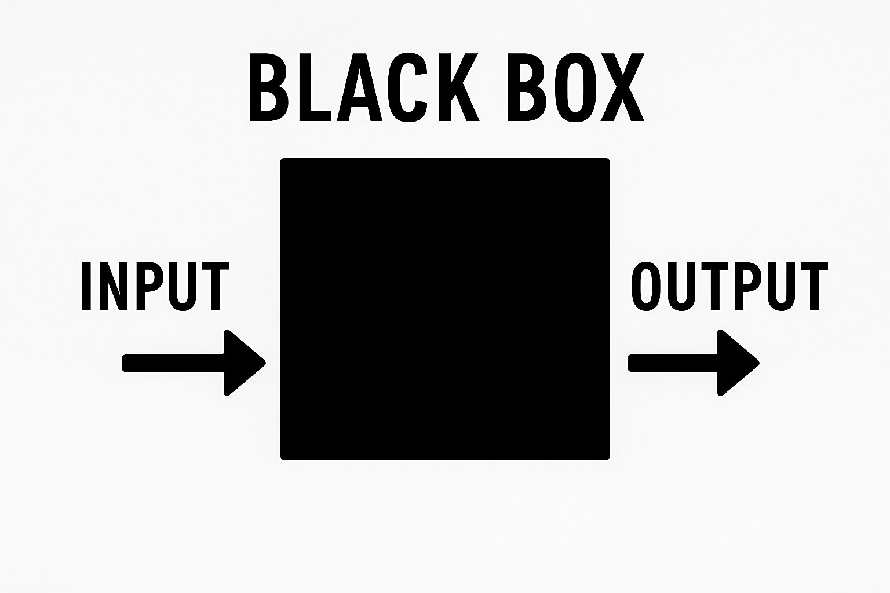

Slide 4
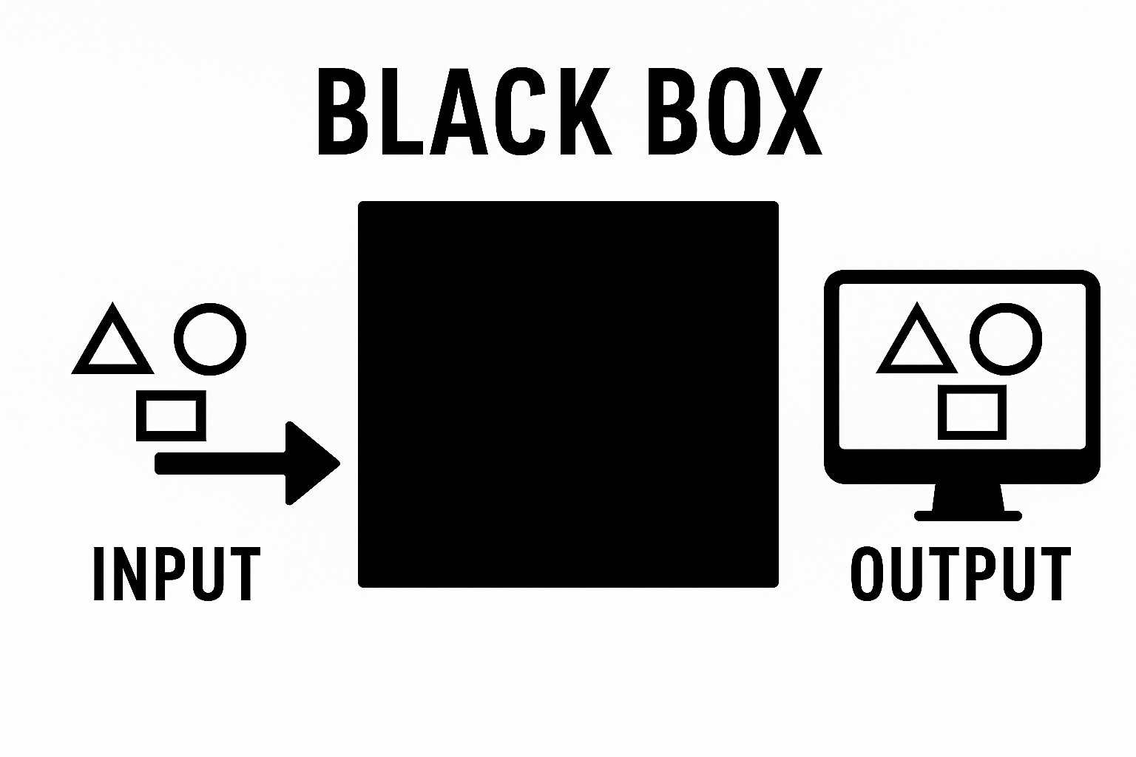

Slide 5
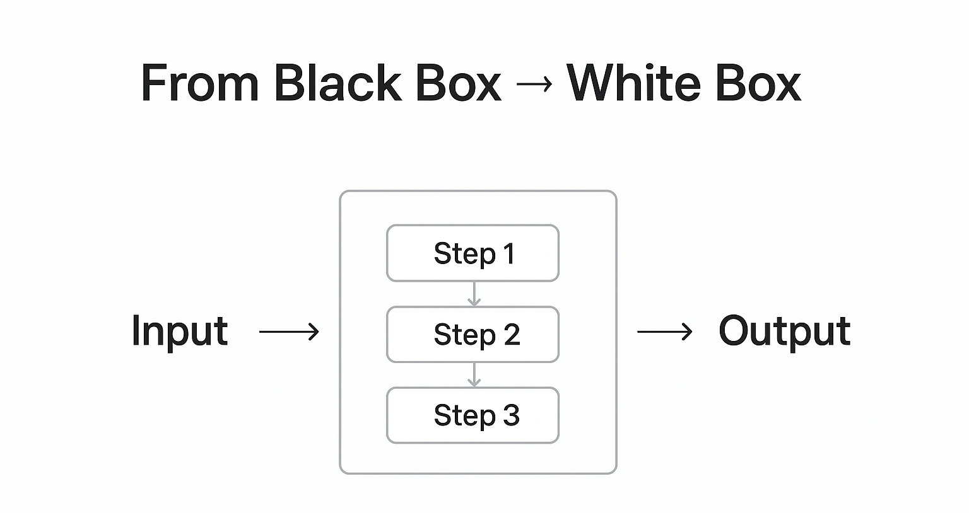

Slide 6
The Problem
Screens are 2D -> flat
We want 3D -> objects have depth
The Challenge (Black Box) -> how do we take 3D geometry and give the perception of depth on a 2D screen.

Slide 7
What Are We Doing Today?
1D -> Drawing a point, moving that point in one axis (screen space and world space).
2D -> Vectors & matrices, transformations, drawing more complex shapes.
3D -> Extending space, model & perspective matrices, transformation matrices, the solution.
*Let’s get down to business

Slide 8

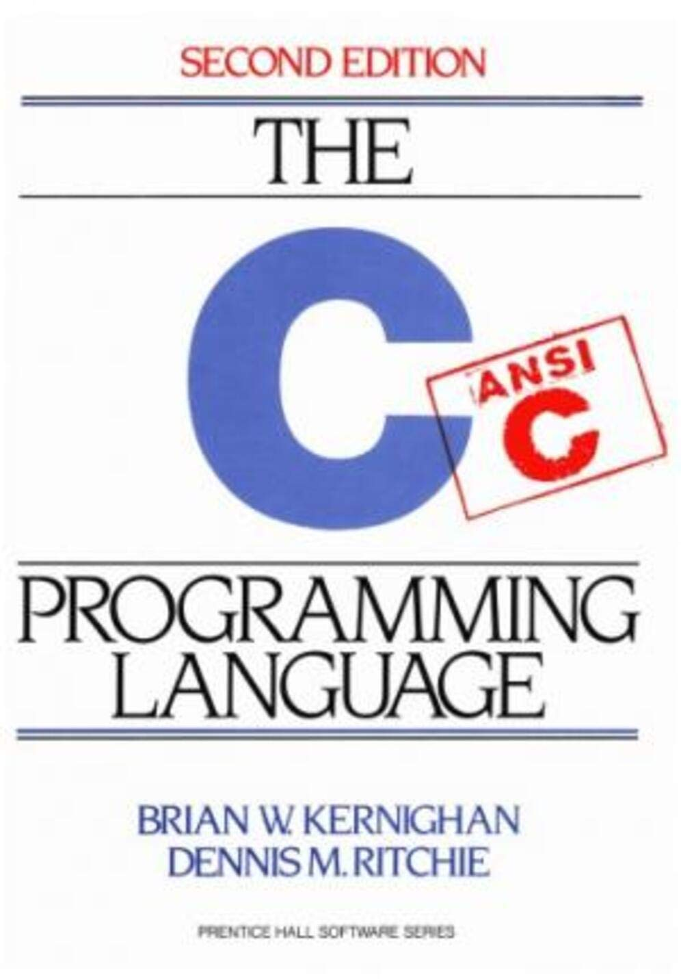

Don’t be afraid of the C (it’s a *simple language)

Slide 9
Setting up the environment…
Go to https://www.raylib.com/
Download raylib, run installer
Setup environmental paths
Download git, run installer
Test setup
*For other operating systems, follow the installation instructions provided on the raylib website/github

Slide 10
Topic 1) 1D

Slide 11

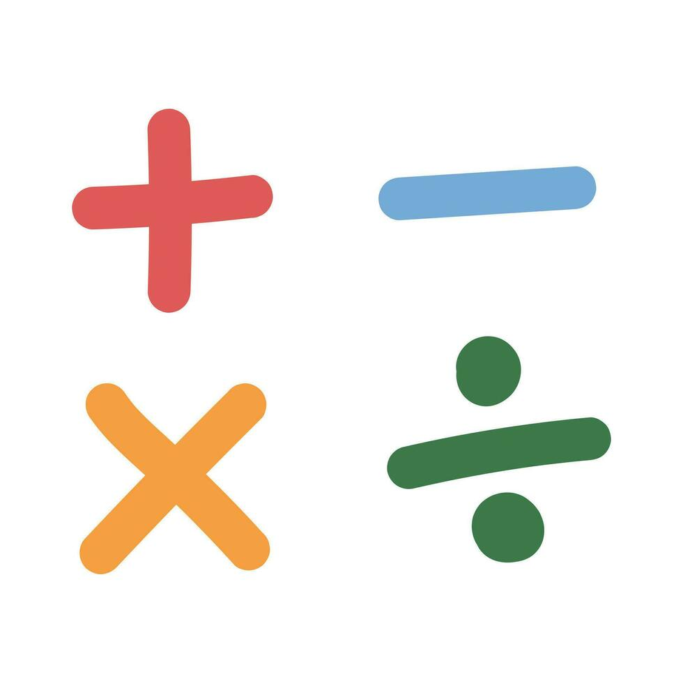
What is space?

Slide 12
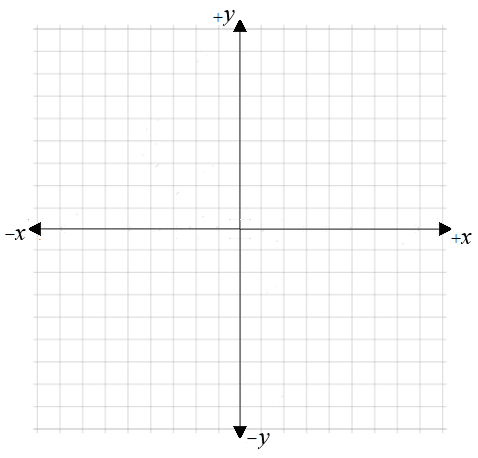
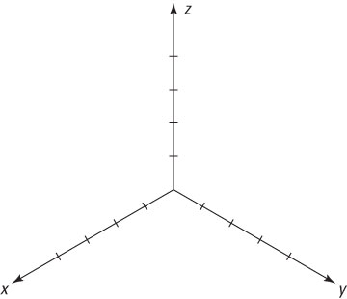
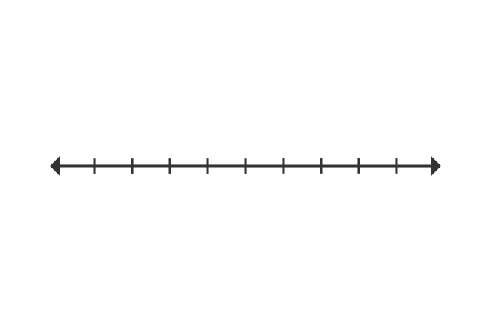
Number Lines (Cartesian Space)
2D
3D
1D
(0, 0)
-x
x
(0, 0, 0)
0

Slide 13
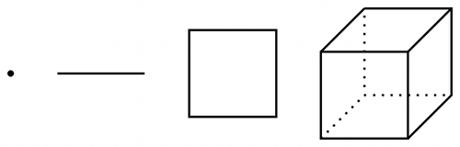
Geometric Primitives (Shapes)

Slide 14
Topic 2) 2D

Slide 15

Vectors?

Slide 16
Vectors
Quantities that can’t be described by a single value.
Examples:
Displacements (x,y)
Velocity (v_{x},v_{y})
Acceleration (ax, ay)
Force (Fx,Fy)
Colors (r,g,b,a)
etc..

Slide 17
Vector Operations
Addition/Subtraction
Multiplication (Scaling)
Get Length (Magnitude)
Make length always equal to 1 (*Normalize)

Slide 18
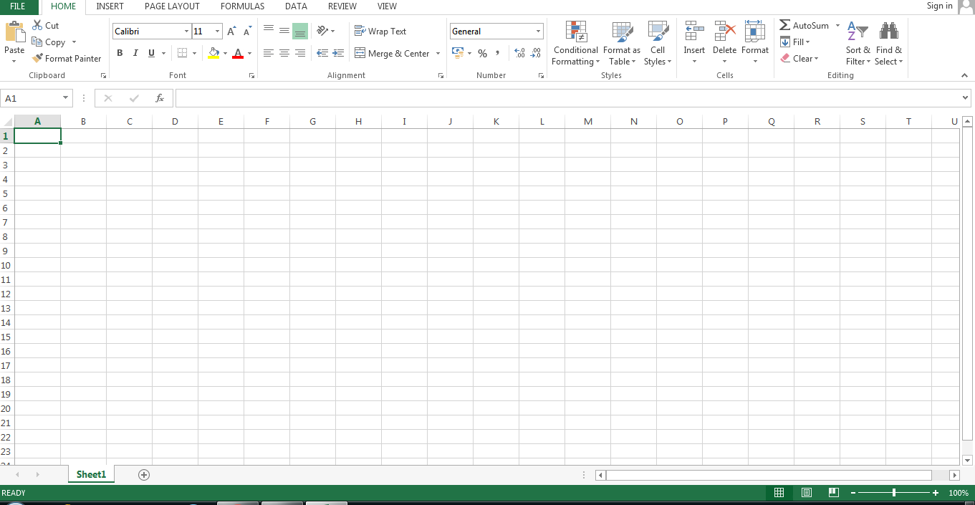
Matrices?

Slide 19
Matrices
Whiteboard example of matrices and their applications.
Matrix-Vector multiplication.
Transformations (translation, scale, rotation).

Slide 20
Transformations

Slide 21
Live Code Example 2

Slide 22

Topic 3) 3D

Slide 23
Vectors cont.
Operations are pretty much identical to 2D.
3D space means we need 3D vectors (x, y, z).
We will also need 4x4 matrices now.
4D vectors? (x, y, z, w)
What is w?

Slide 24
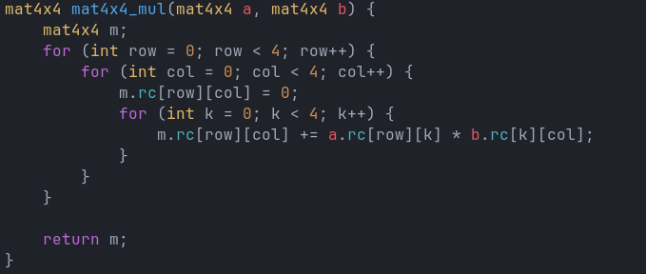
Matrices cont.
Matrix-Matrix multiplication.
Higher Dimension Matrix-Vector multiplication.

Slide 25
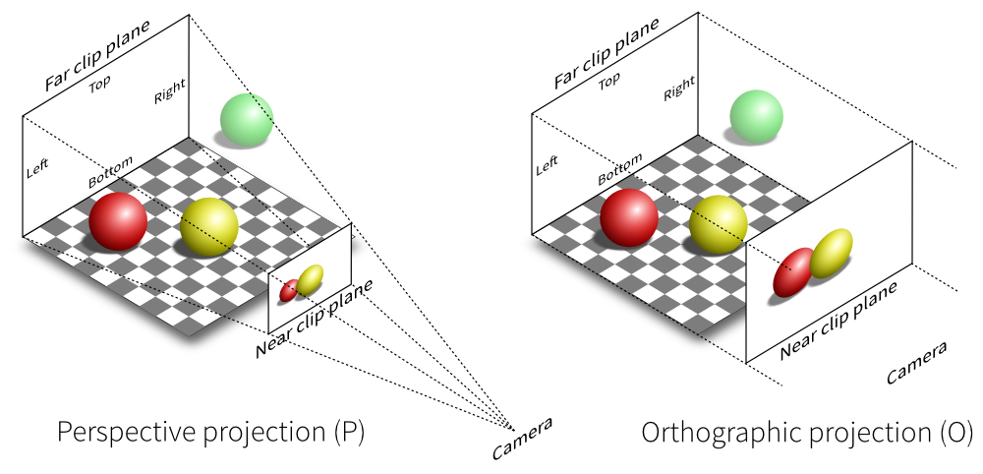
Matrices cont.

Slide 26
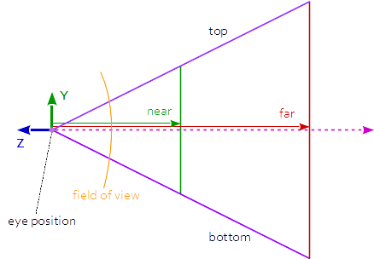
Matrices (Perspective Projection)
Objects in distance appear smaller.

Slide 27
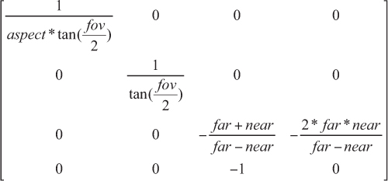
Matrices (Perspective Projection)

Slide 28
Live Code Example 3

Slide 29
Live Code Example 4

Slide 30


Slide 31


